Slide 1
Energy Consumption
Forecasting
Machine Learning Approach for Hourly Electricity Demand Prediction
Elif Erkişi | 042401169
DSAI 302 – Capstone Project | Instructor: Tuna Çakar | MEF University
April 2026

Slide 2
Agenda
01
Introduction & Problem Statement
05
Results & Model Comparison
02
Dataset & Exploratory Data Analysis
06
Discussion & Future Work
03
Feature Engineering & Preprocessing
07
Demo – Streamlit Application
04
Methodology & Model Selection
08
Conclusion

Slide 3
Introduction & Problem Statement
Why Energy Forecasting?
121,107
14 years
Electricity demand fluctuates hourly. Accurate forecasting enables grid operators to balance supply and demand efficiently, minimizing costs and reducing waste.
hourly records
2004 – 2018
Problem Statement
Predict hourly electricity consumption (MW) for a regional grid using historical patterns and temporal features.
R² = 0.9888
MAE ≈ 26 MW
Dataset
CV Score
Final Model
121,107 hourly records spanning 2004–2018, sourced from a regional energy operator. Zero missing values after preprocessing.
Approach
Engineer lag and rolling features from raw timestamps, then benchmark ML models to find the best performer via cross-validation.

Slide 4
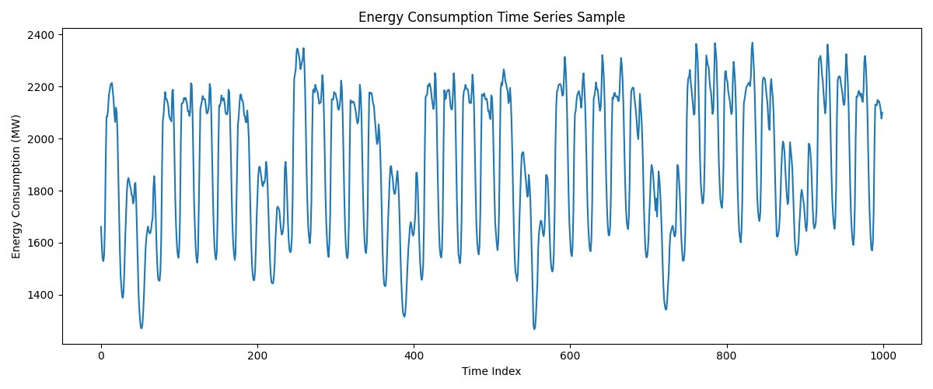
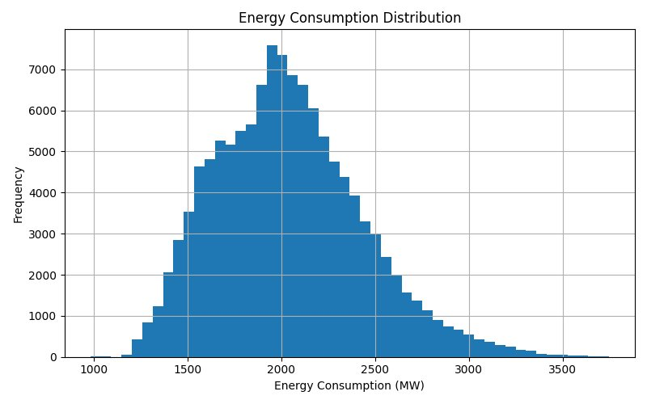
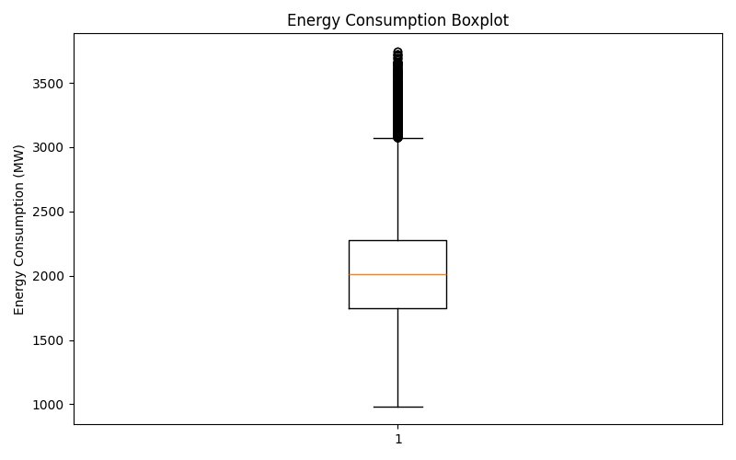
Exploratory Data Analysis – Dataset Overview
Summary Statistics
Mean
2,038 MW
Std Dev
393 MW
Min
982 MW
Max
3,746 MW
Median
2,009 MW
Records
121,107
Energy Consumption Distribution
Boxplot – Outlier Detection

Slide 5
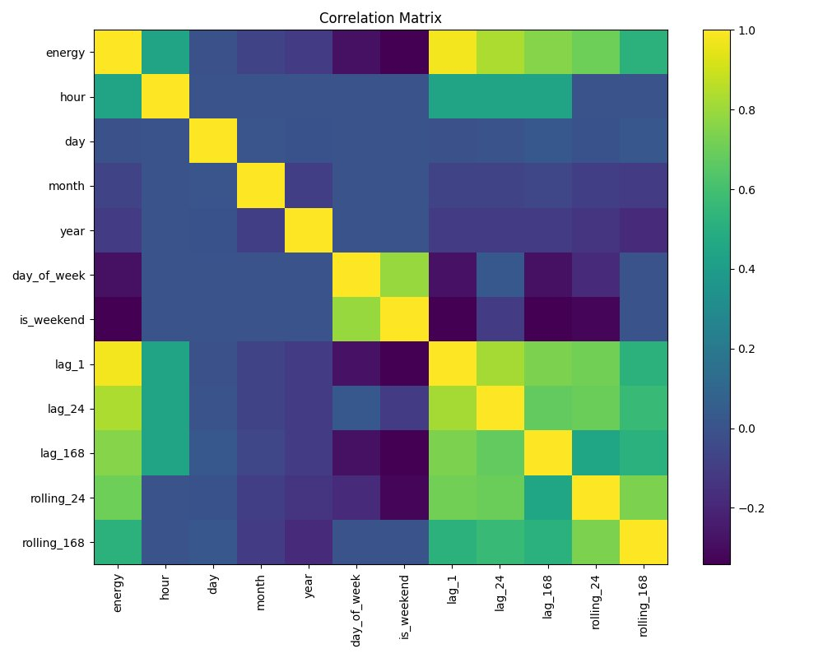
Exploratory Data Analysis – Correlations & Features
Key Correlation Findings
lag_1 ↔ energy
Highest correlation (~0.97). Previous hour energy is the strongest predictor.
lag_24 & rolling_24
Strong positive correlation. Daily patterns captured well.
hour & energy
Moderate correlation – time-of-day drives demand cycles.
is_weekend
Negative correlation – lower consumption on weekends.
year
Near-zero – no strong long-term trend in the dataset period.

Slide 6
Feature Engineering & Preprocessing
Temporal Features
Lag Features
▸ hour, day, month, year
▸ lag_1: t-1 hour energy
▸ day_of_week
▸ lag_24: t-24 (same hour yesterday)
▸ is_weekend (binary)
▸ lag_168: t-168 (same hour last week)
Rolling Averages
Data Quality
▸ rolling_24: 24-hour mean
▸ Zero missing values
▸ rolling_168: 7-day mean
▸ 121,107 clean records
▸ Captures short/long-term trends
▸ No imputation needed
Total: 12 engineered features feeding the ML pipeline | Train/Test split: 80% / 20% (chronological)

Slide 7
Methodology & Model Selection
Raw Data
Feature Eng.
Train/Test Split
Model Training
Evaluation
Tuning
Model
Description
Test Performance
Notes
Linear Regression
Baseline linear model
R²=0.957 / MAE≈82 MW
Fast, interpretable
Decision Tree
Non-linear splits
R²=0.999 / MAE≈26 MW
Best MAE, interpretable
★ Selected
Random Forest
Ensemble of trees
R²=0.999 / MAE≈29 MW
Robust, slower
Gradient Boosting
Sequential ensemble
R²=0.999 / MAE≈31 MW
High accuracy, slow
Final model: Tuned Decision Tree – max_depth=10, min_samples_split=5, min_samples_leaf=2

Slide 8
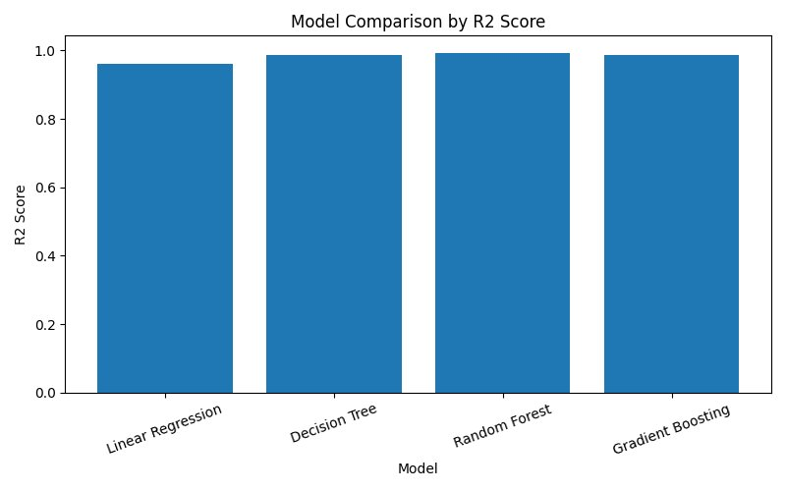
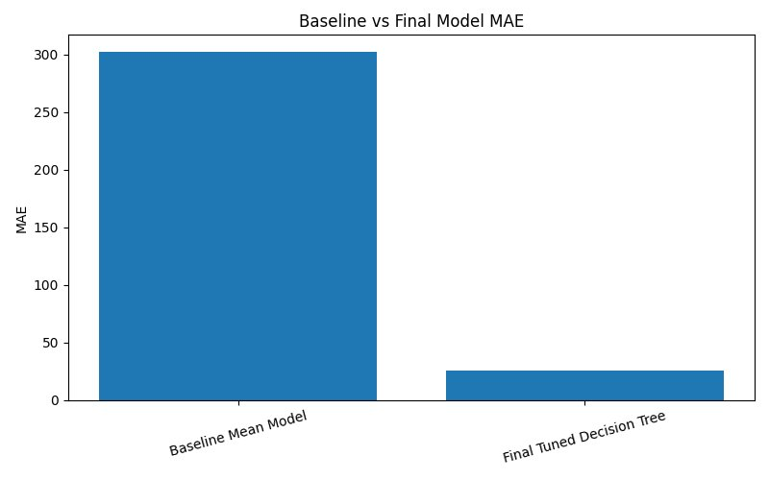
Results – Model Comparison
R² Score by Model
Baseline vs. Final Model MAE
R² = 0.9999
MAE = 26 MW
CV R² = 0.9888
91% reduction
Decision Tree
vs Baseline 302 MW
5-Fold Cross-Val
in MAE

Slide 9
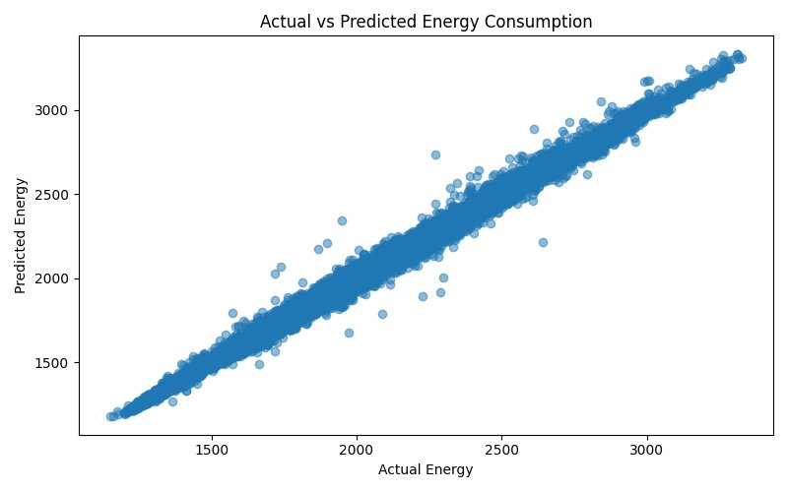
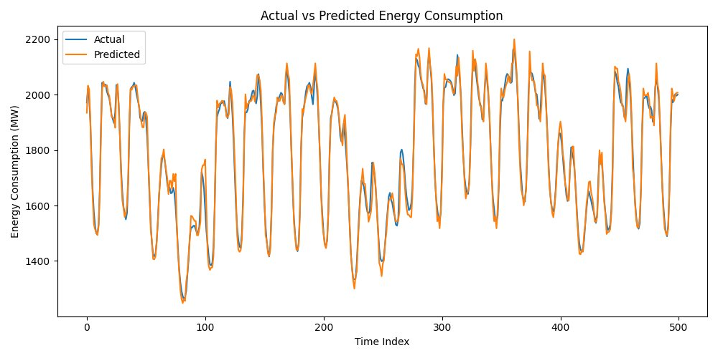
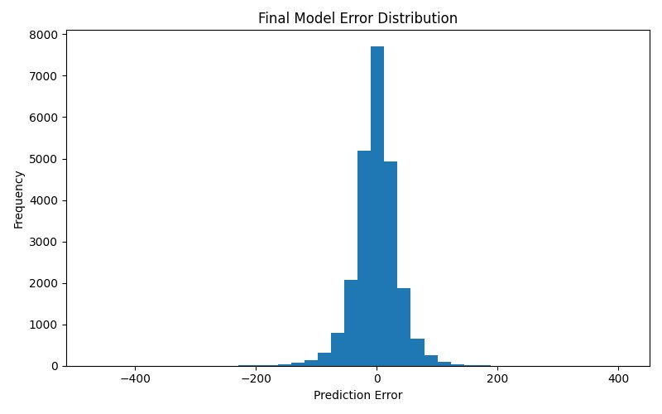
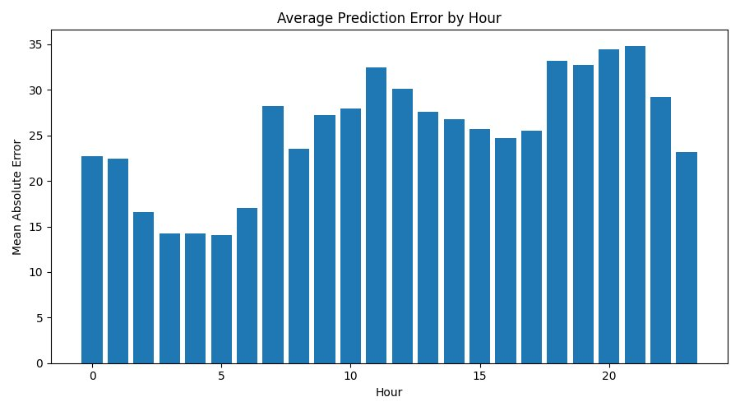
Results – Actual vs Predicted Energy
Scatter: Actual vs Predicted (MW)
Time Series: 500 sample predictions
The scatter plot shows extremely tight alignment along the 45° diagonal. The time series overlay demonstrates near-perfect tracking of actual demand cycles, including peaks and valleys.

Slide 10
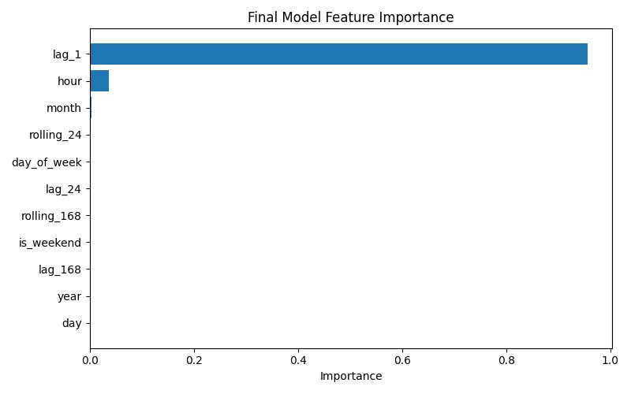
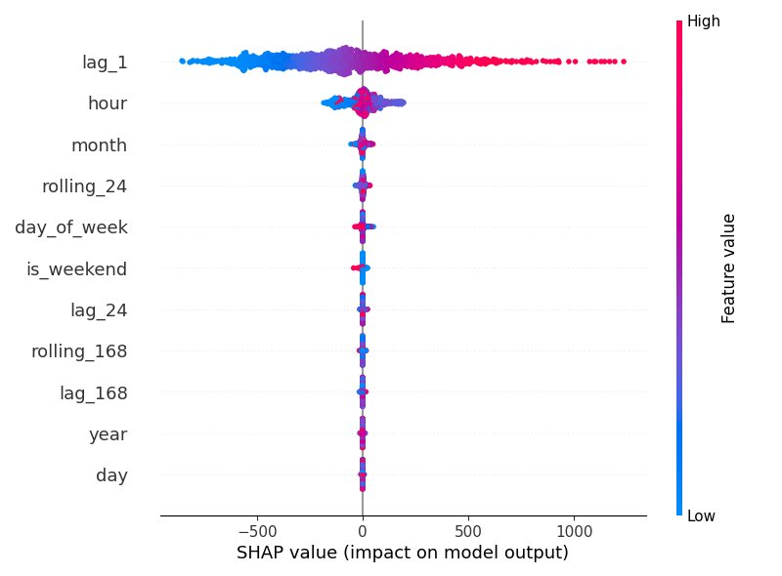
Feature Importance & SHAP Analysis
Decision Tree Feature Importance
SHAP Summary Plot
▸ lag_1 dominates (~95% importance) — energy at t-1 is the single most informative signal.
▸ hour contributes ~4% — time-of-day patterns drive the remaining variance.
▸ SHAP confirms: high lag_1 values push predictions upward; hour creates nonlinear demand cycles.

Slide 11
Discussion & Future Work
Findings
Limitations
Future Work
lag_1 alone accounts for ~95% of predictive power — strong autocorrelation in energy demand.
No weather data (temperature, humidity) which are key drivers of energy demand.
Integrate meteorological features (temperature, wind speed, solar irradiance).
Tuned Decision Tree outperforms ensemble methods on this dataset, likely due to clear decision boundaries.
lag_1 dominance may reduce robustness when predicting further into the future (multi-step).
Explore LSTM / Transformer models for long-horizon multi-step forecasting.
MAE reduced from ~302 MW (baseline) to ~26 MW — a 91% improvement.
Model trained on a single region — generalizability not tested.
Add holiday and event calendars as categorical features.
Error distribution is symmetric and centered at zero, indicating no systematic bias.
No external shocks (holidays, industrial events) encoded as features.
Deploy as real-time API with MLflow model registry and monitoring dashboard.

Slide 12
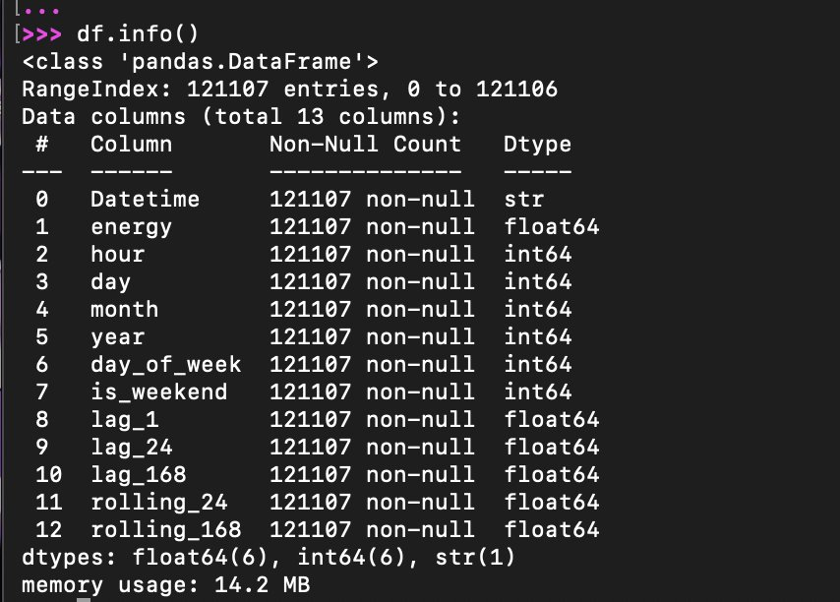
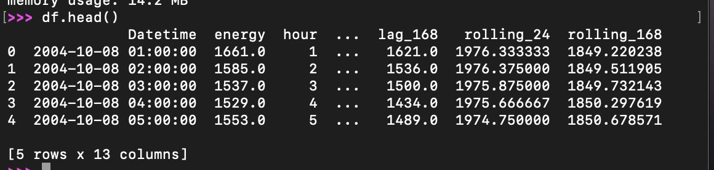
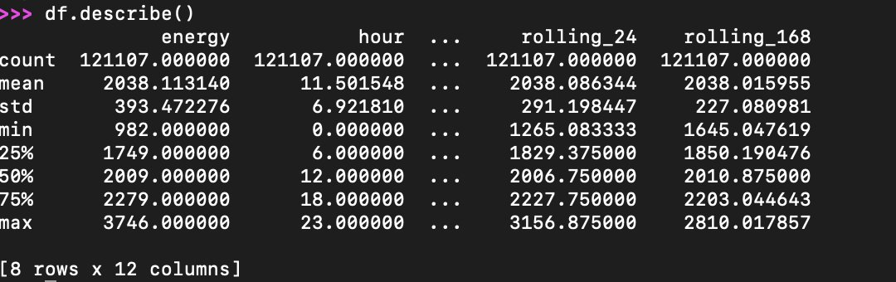
Demo – Streamlit Application
Interactive EDA Dashboard
Model Comparison Panel
Live Prediction Interface
✓ Interactive EDA visualizations (distributions, time-series, correlations)
✓ Model benchmarking with real-time metric comparison
✓ Custom prediction input form with instant MW forecasts
✓ SHAP explanation viewer for individual predictions

Slide 13
Conclusion
1
A tuned Decision Tree achieves R² = 0.9888 (CV) and MAE ≈ 26 MW on 121,107 hourly records.
2
Lag-1 feature dominates prediction — confirming strong short-term autocorrelation in energy demand.
3
91% MAE improvement over the naive baseline model demonstrates real practical value.
4
The Streamlit application brings the model to life with interactive forecasting and explainability.
5
Future integration of weather data and deep learning promises further gains.
Elif Erkişi | 042401169 | DSAI 302 – MEF University | April 2026

